Slide 1
Cancer Data Science 101: Data Science Methodology
Randy Johnson, PhD Advanced Biomedical Computational Science
April 23, 2019

Slide 2
Overview
Scientific method - Data science plays a role in
Study design
Study execution
Data analysis and interpretation
Publication
Communication
Scientific Integrity
P-hacking
Data management
Data sharing

Slide 3
Scientific Method
Hypothesis
Gather information
Formulate a question
Develop a hypothesis
Make a testable prediction
Data
Perform experiment
Collect data
Analyze data
Conclusion
Evaluate the hypothesis
Revise hypothesis as needed
Publish results
Repeat

Slide 4
Study Design
What is the study population?
What data do we have?
What data can we collect?
What is the question?
What is the test?
How can we minimize potential sources of bias?

Slide 5
Example: Analysis of an extreme subpopulation
Kopp et al reference goes here

Slide 6
Study Execution
Monitoring of data as it is collected
Monitoring different arms of a clinical trial to ensure patient safety
Identifying key indicators to measure risk
Setting benchmarks to trigger contingency plans
Checking data for quality assurance purposes

Slide 7
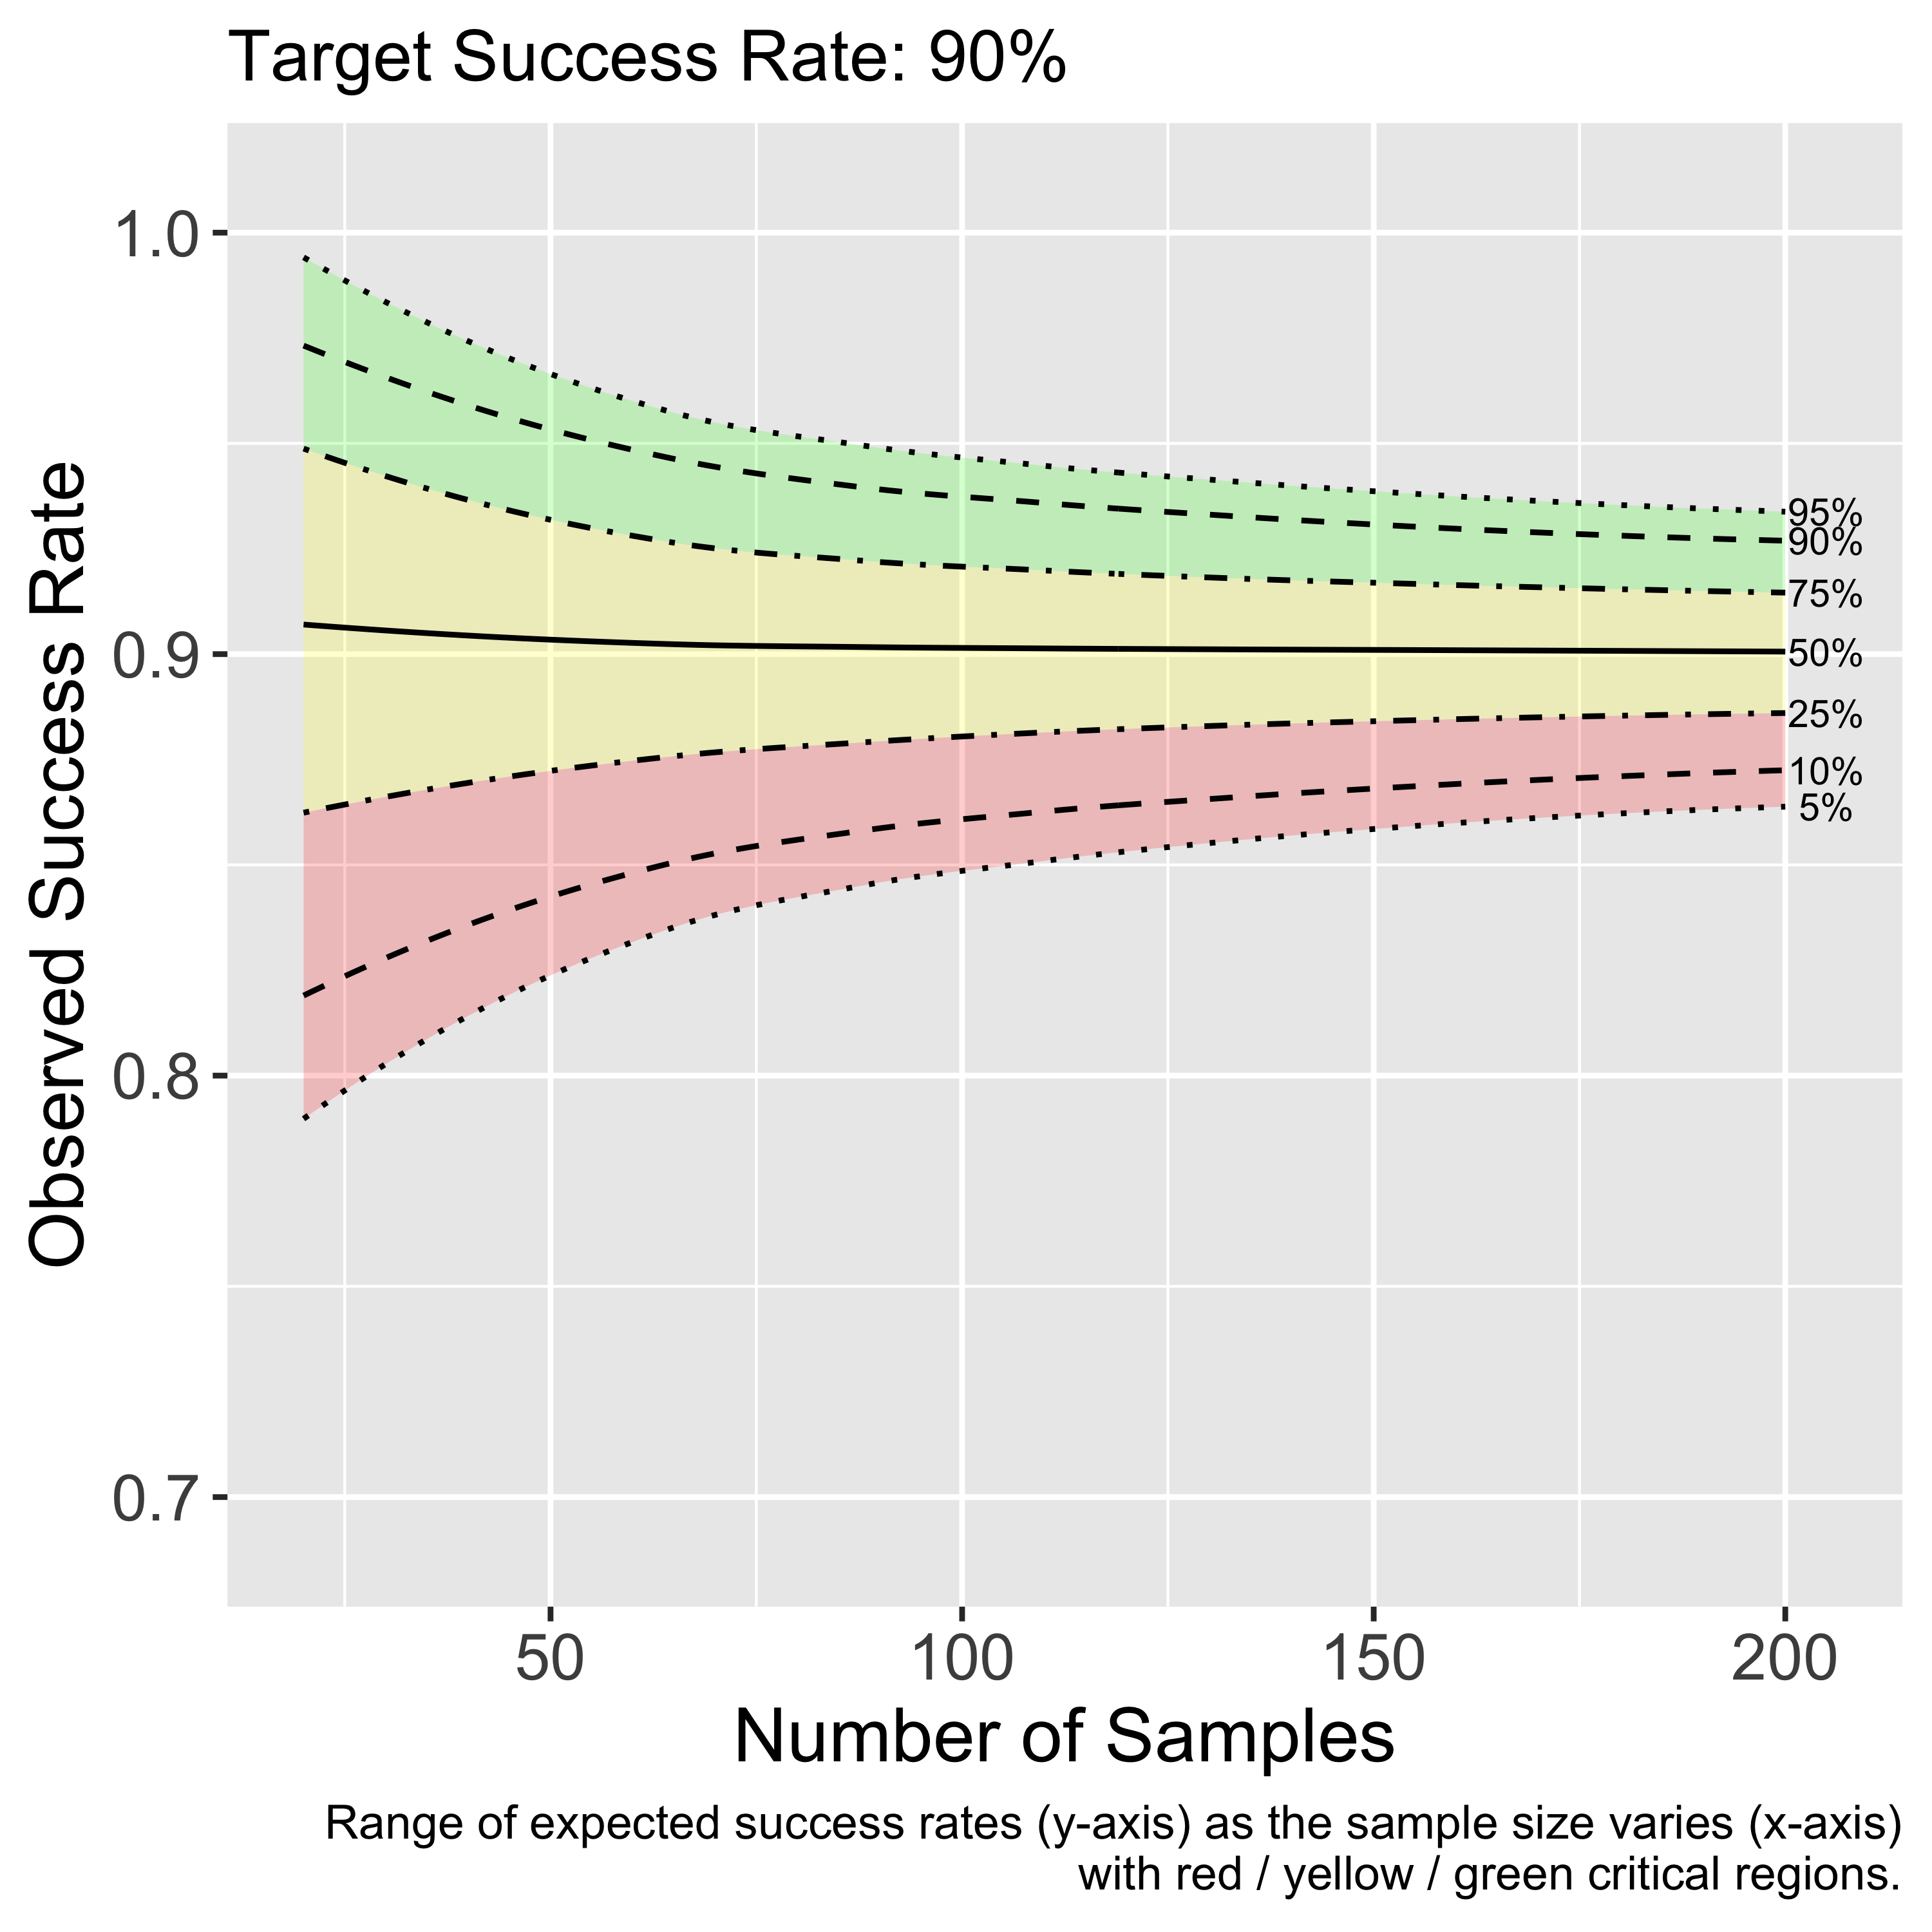
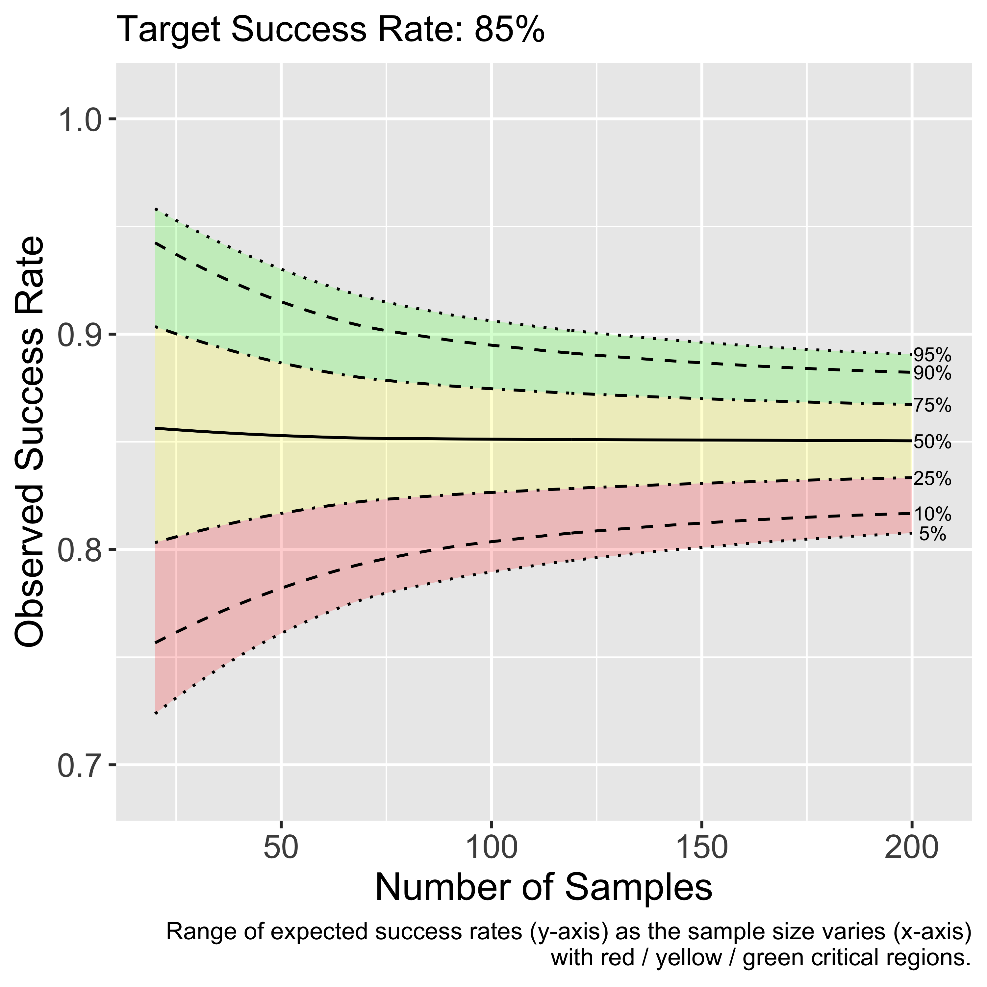
Example: Monitoring quality in a multicenter study

Slide 8
Data Analysis and Interpretation
Plan the analysis when you design your study
Do we have sufficient statistical power to ask this question?
How many samples do I need?
Evaluate assumptions
What assumptions have we made?
Are they reasonable?
Analyze and interpret the data
What are the appropriate tools?
What do the data tell us about our hypothesis?

Slide 9
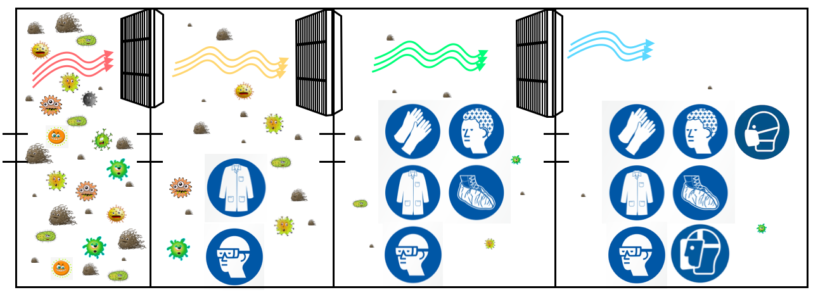
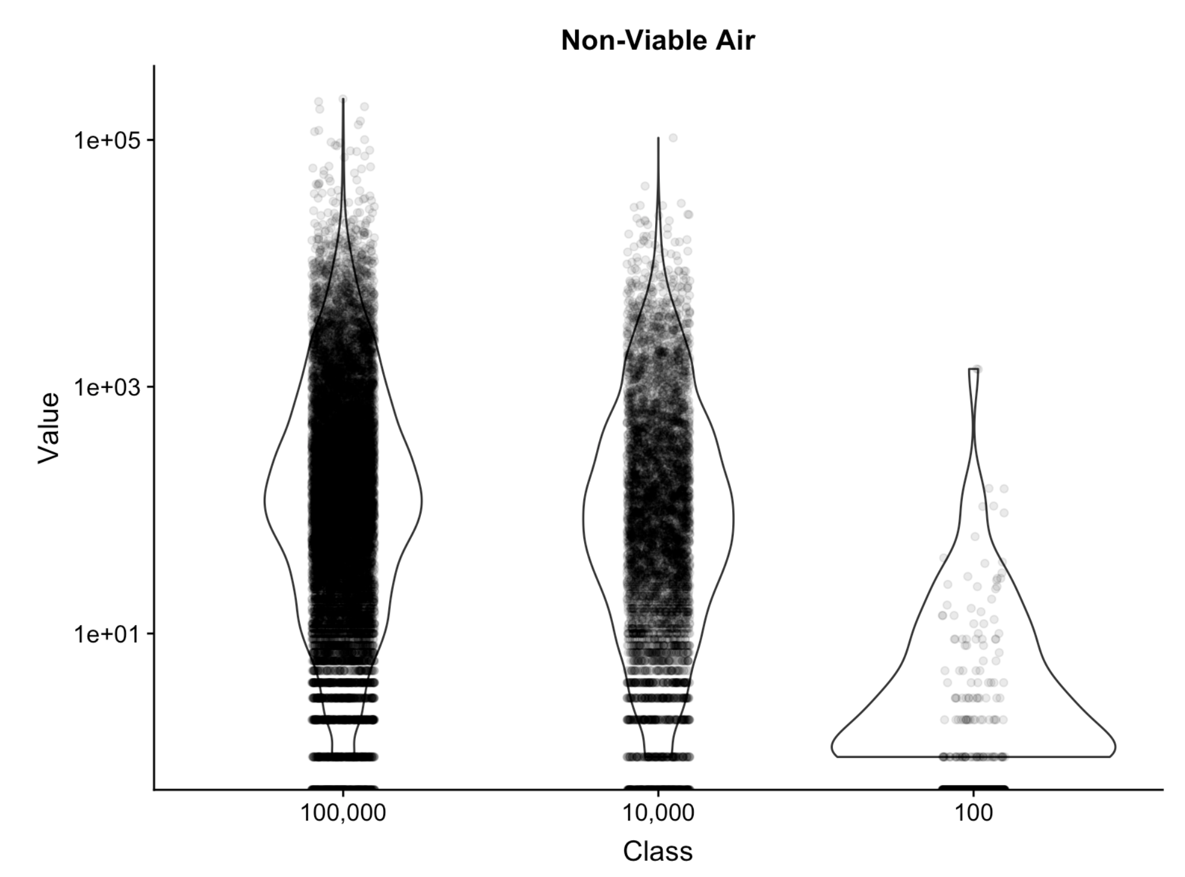
Example: Environmental Monitoring Data

Slide 10
Communication
Computer
Science
Subject
Matter
Expertise
Math and
Statistics
Data
Science

Slide 11
Communication: Revelation of the Complex
What is to be sought in designs for the display of information is the clear portrayal of complexity. Not the complication of the simple; rather the task of the designer is to give visual access to the subtle and the difficult — that is,
the revelation of the complex.
Edward Tufte
The Visual Display of Quantitative Information

Slide 12
Data Visualization Principles
What people see should be what the data are trying to say.
A figure should be worth a thousand words, but it shouldn't require a thousand words to describe it.
Anything that distracts from the visualization should be left out.

Slide 13
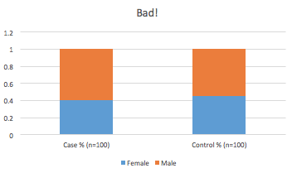
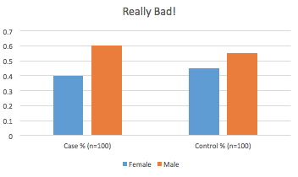
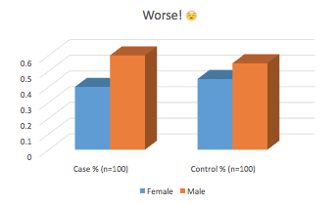
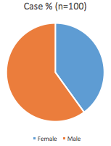
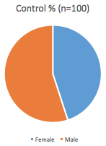
Data Visualization: Sometimes text is best

Slide 14
Data Visualization: Sometimes text is best
40% of cases and 45% of controls were female (p = 0.24)

Slide 15
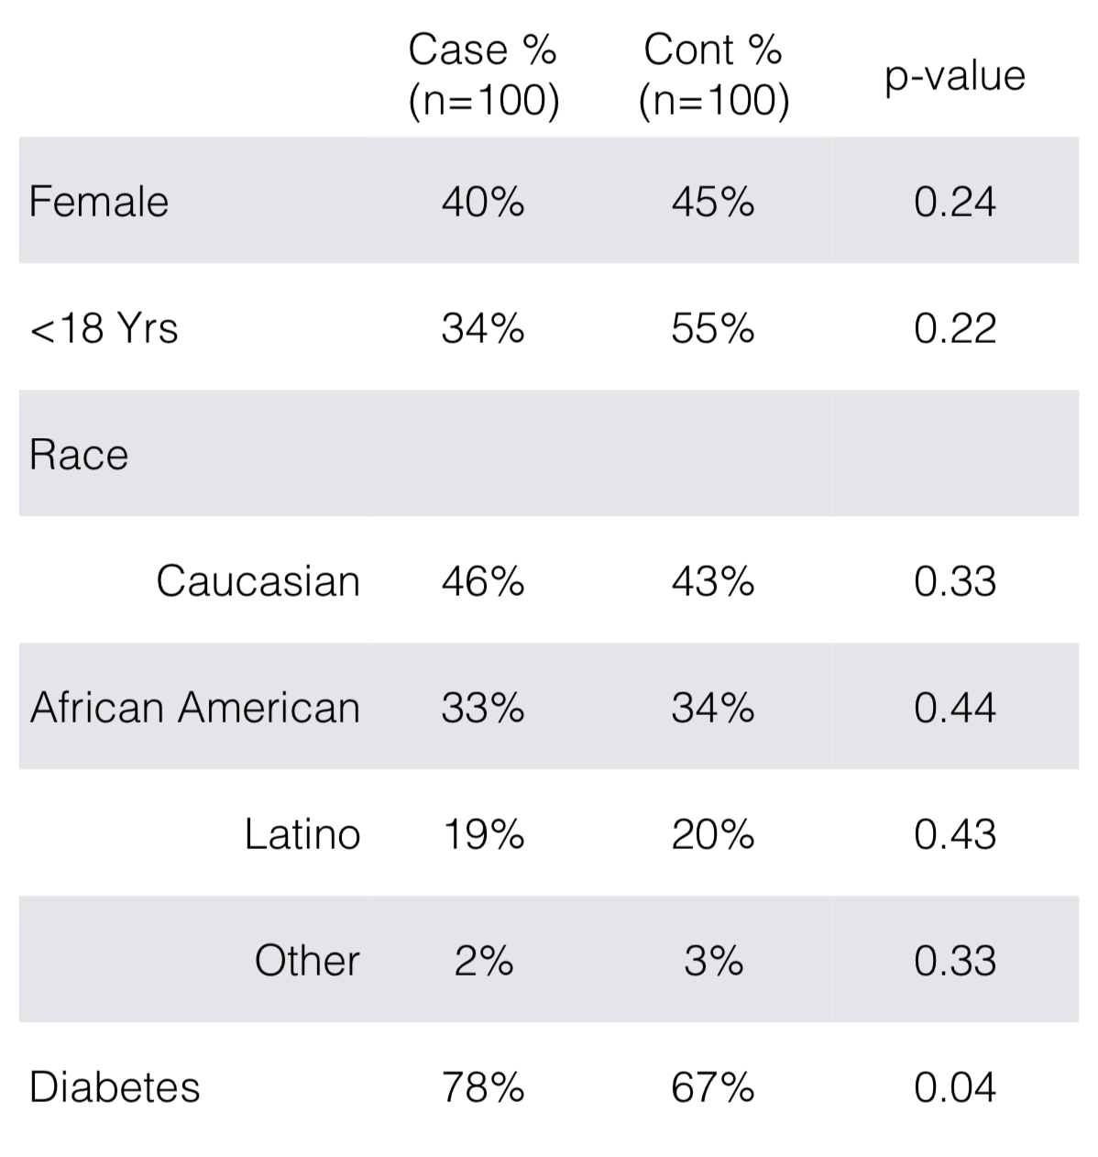
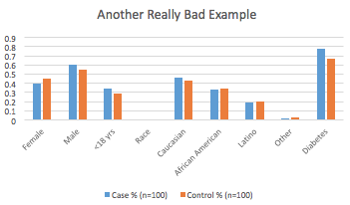
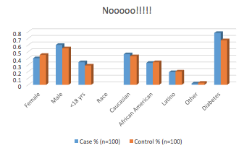
Data Visualization: Tables

Slide 16
Data Visualization: Box and Violin Plots

Slide 17
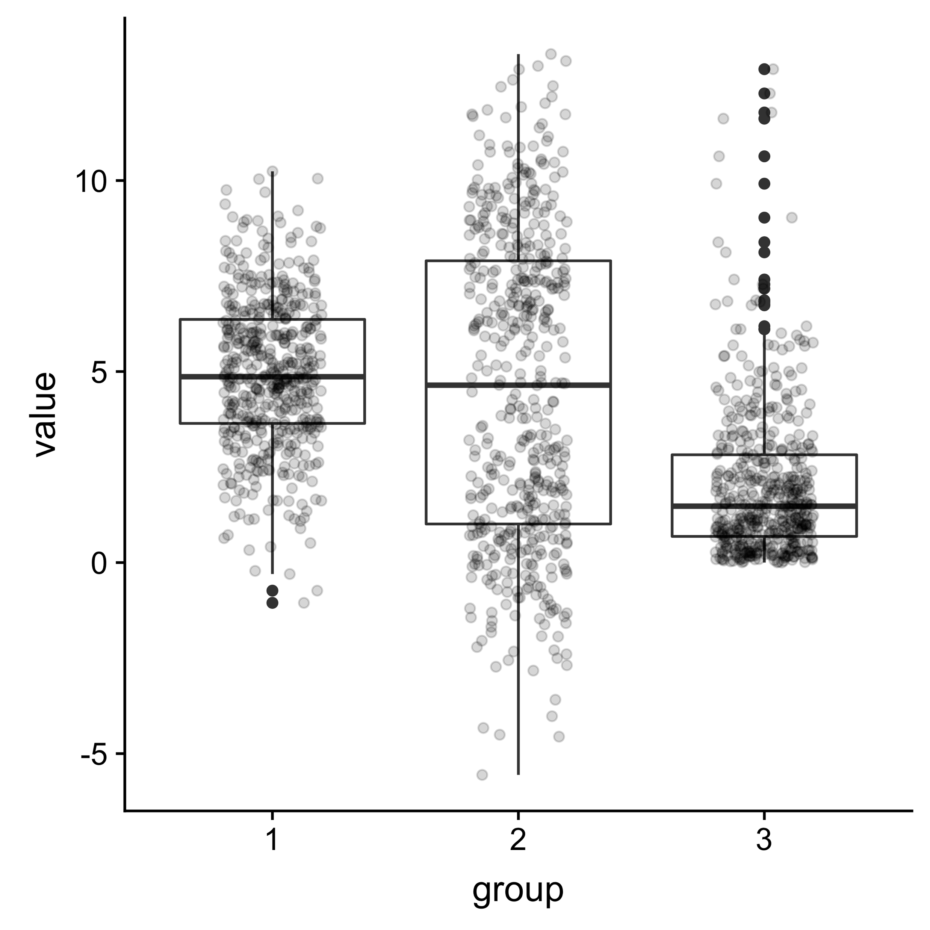
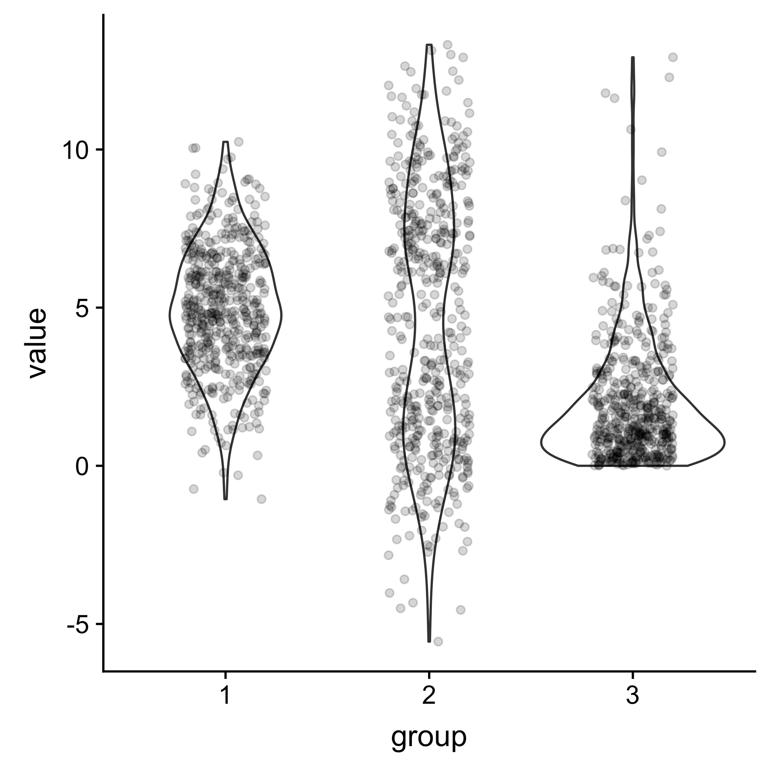
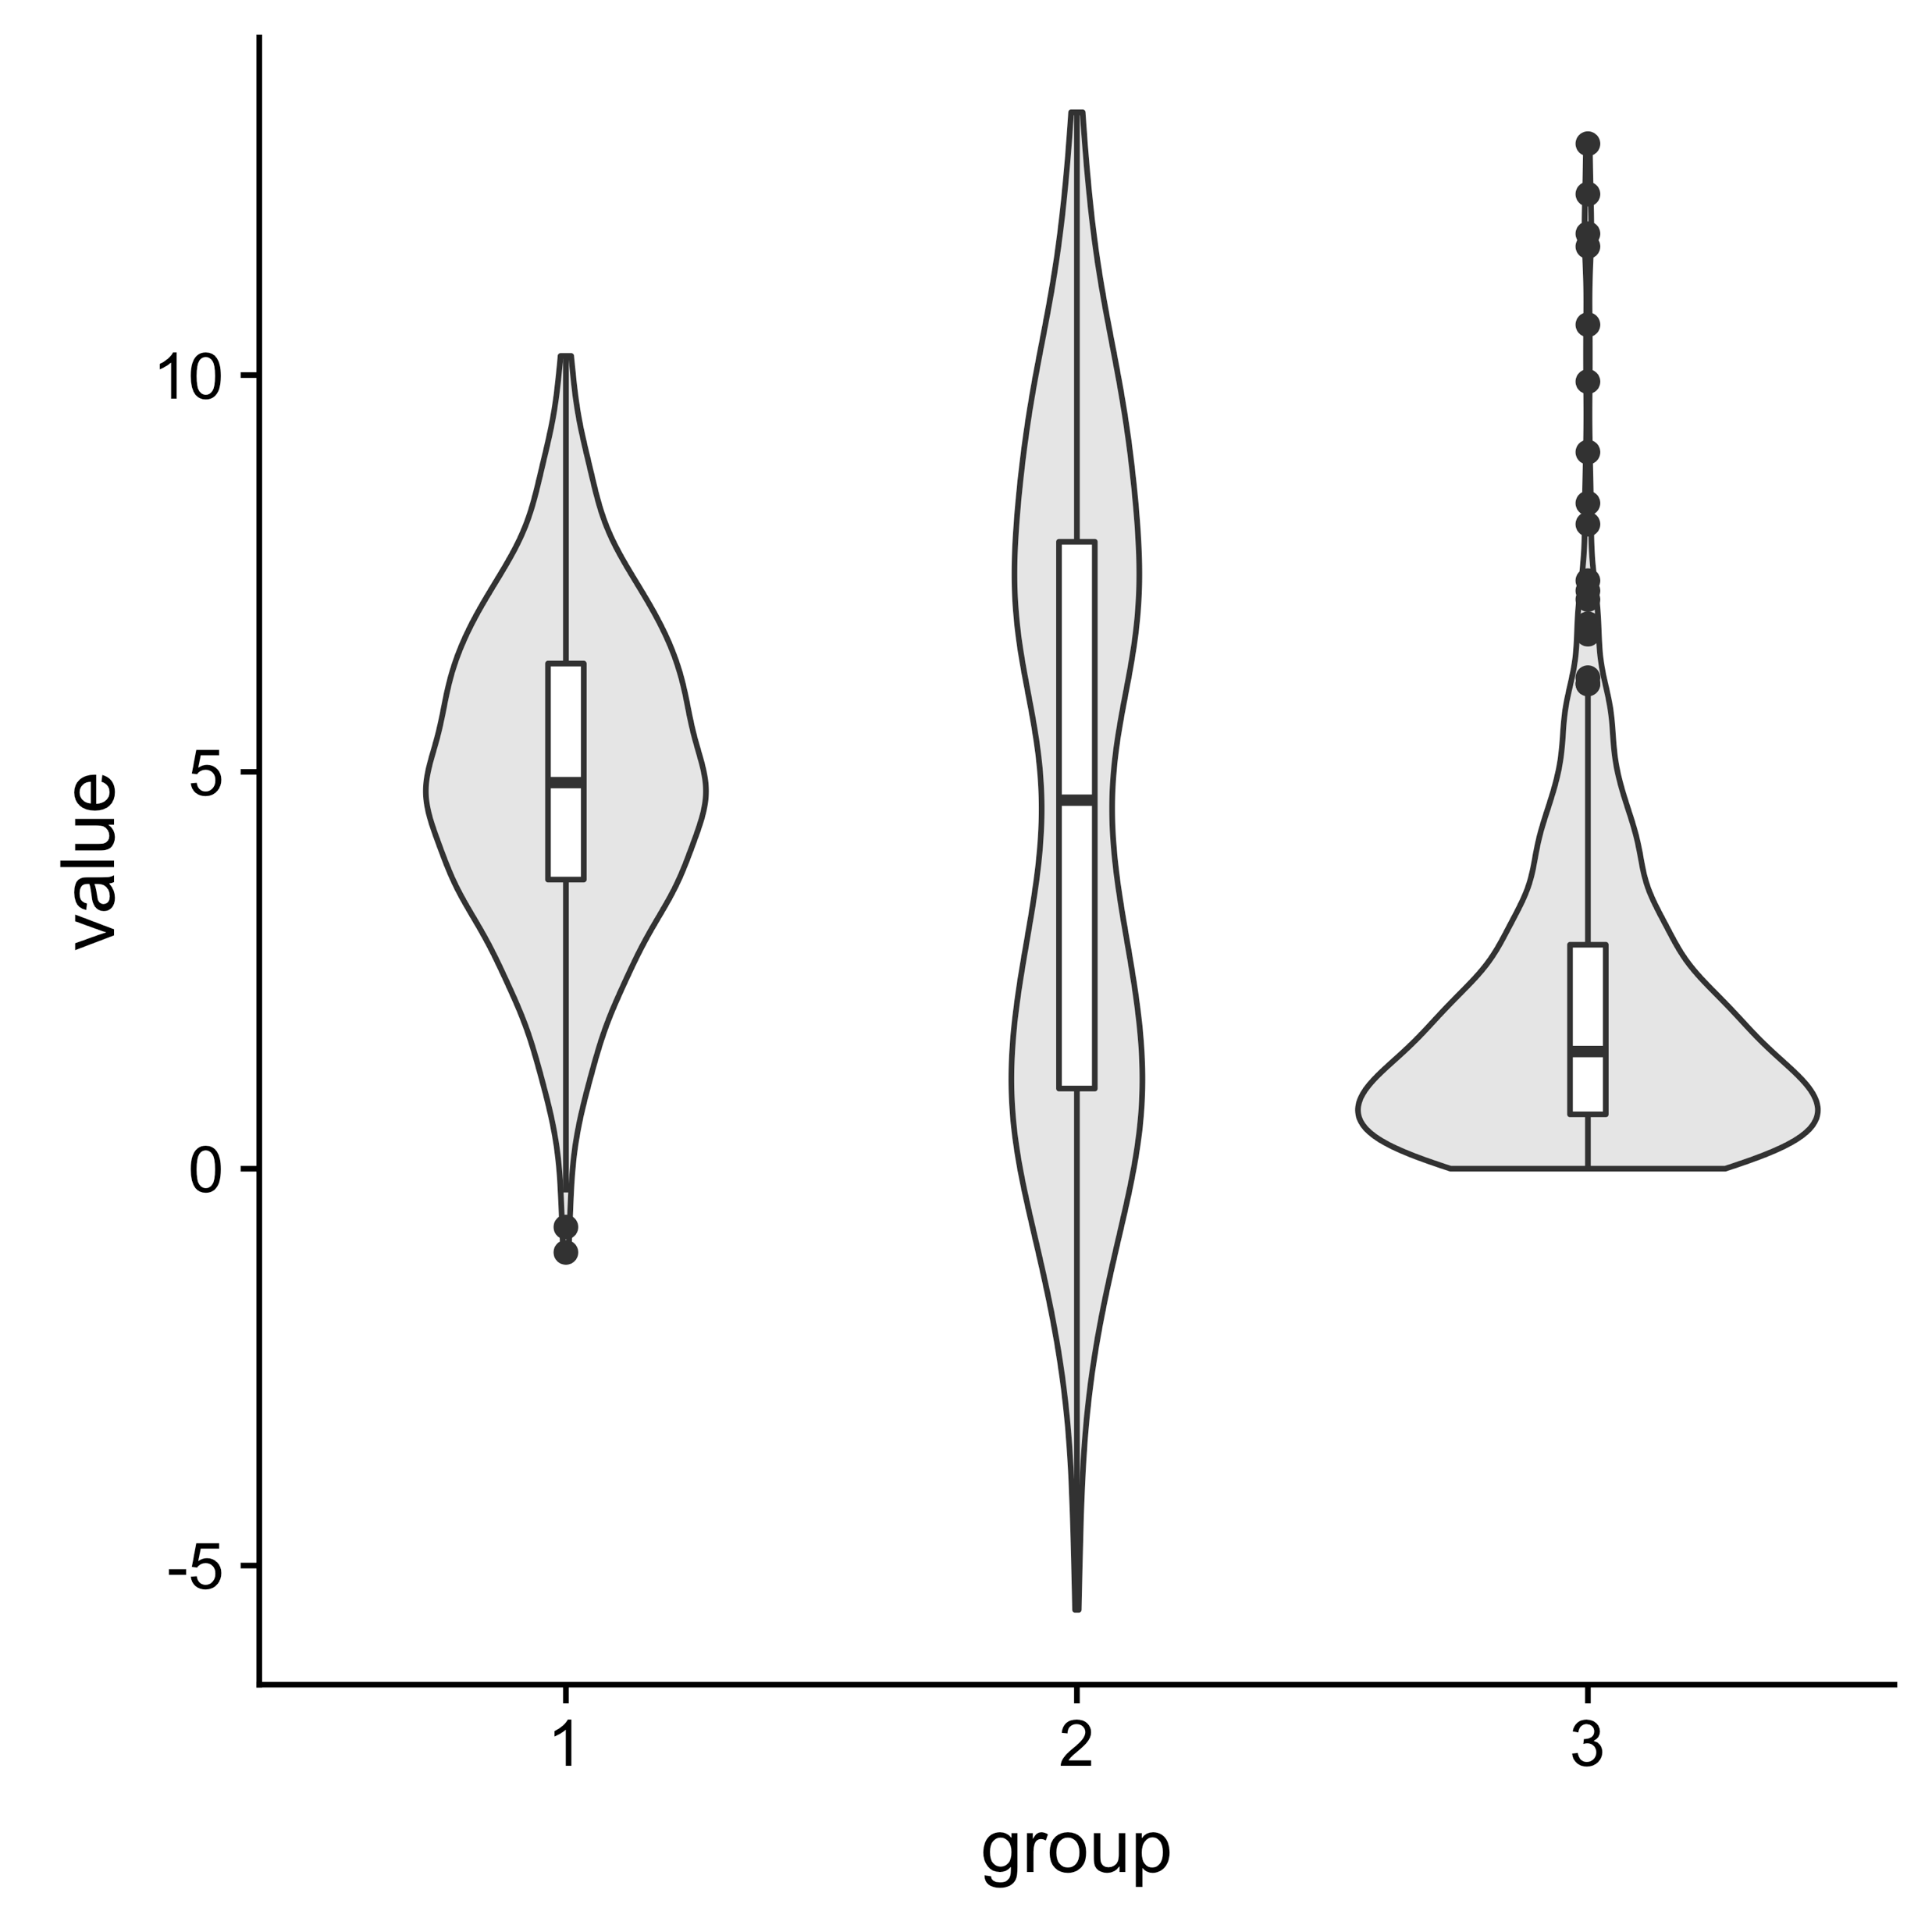
Data Visualization: Box and Violin Plots

Slide 18
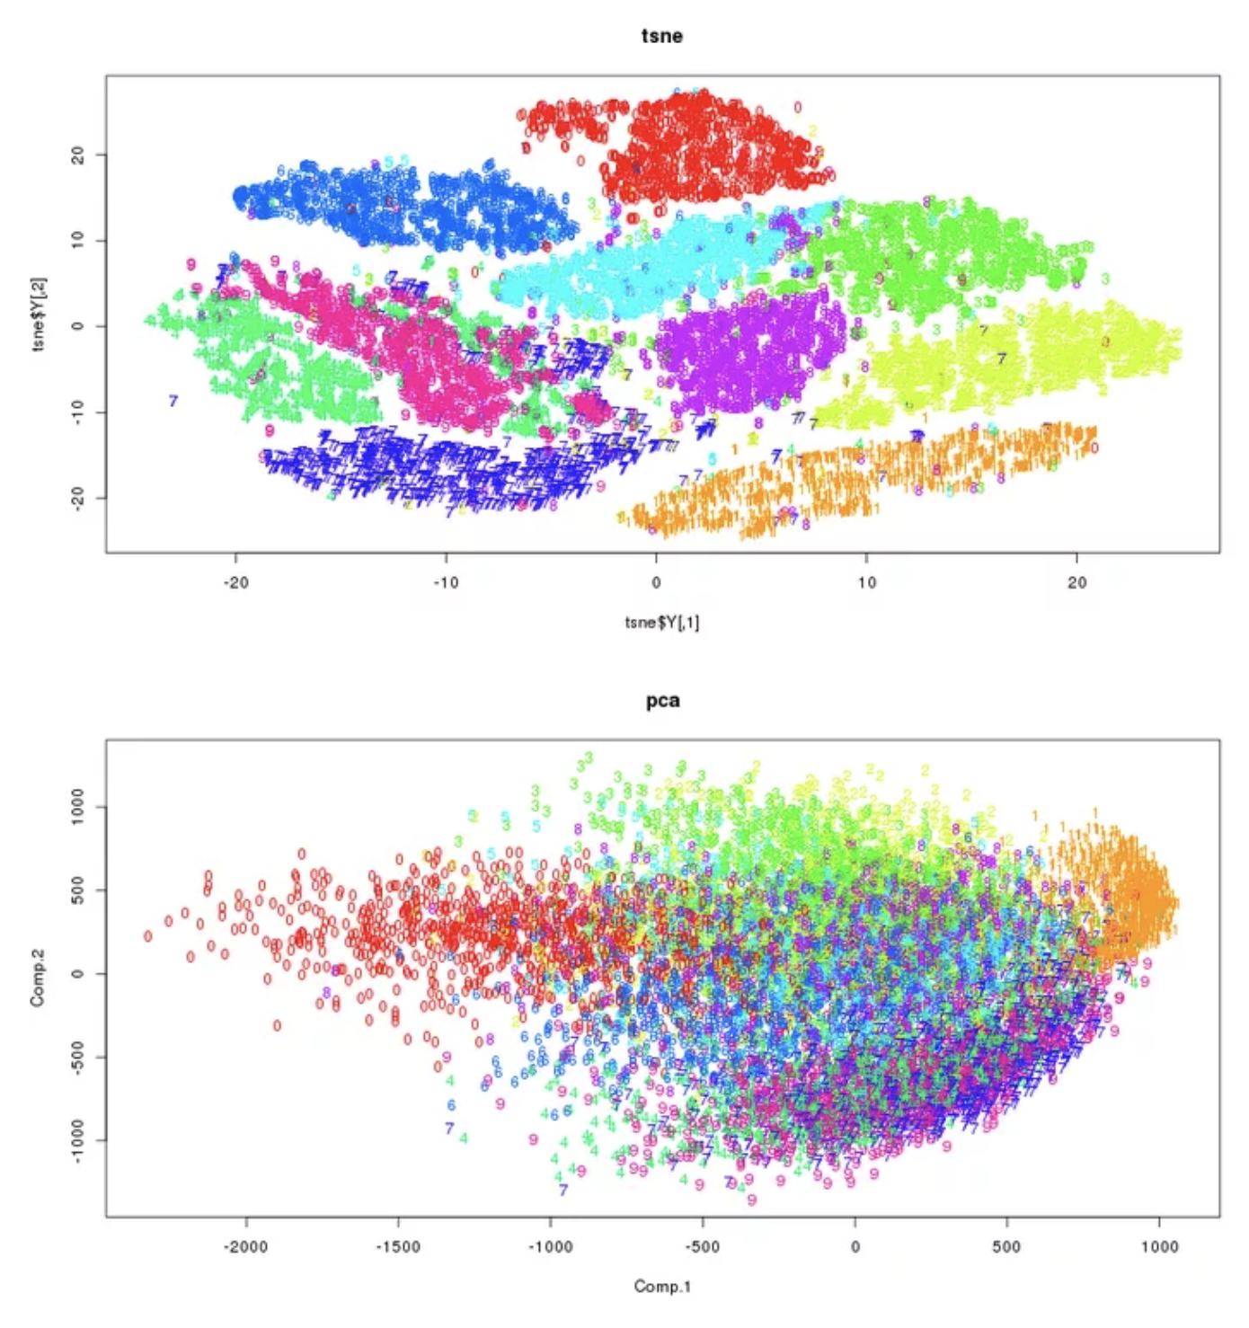
Data Visualization: High Dimensional Data
t-Distributed Stochastic Neighbor
Embedding (t-SNE)
Principal Component Analysis (PCA)
https://www.r-bloggers.com/playing-with-dimensions-from-clustering-pca-t-sne-to-carl-sagan/

Slide 19
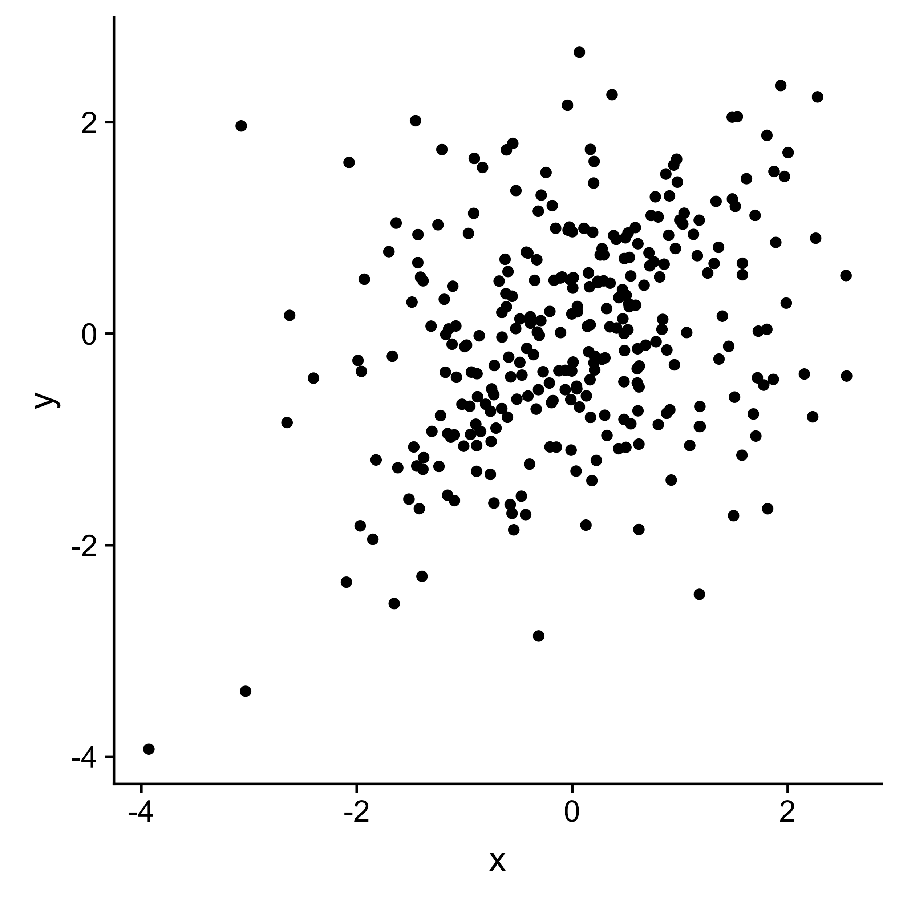
Data Visualization: Color

Slide 20
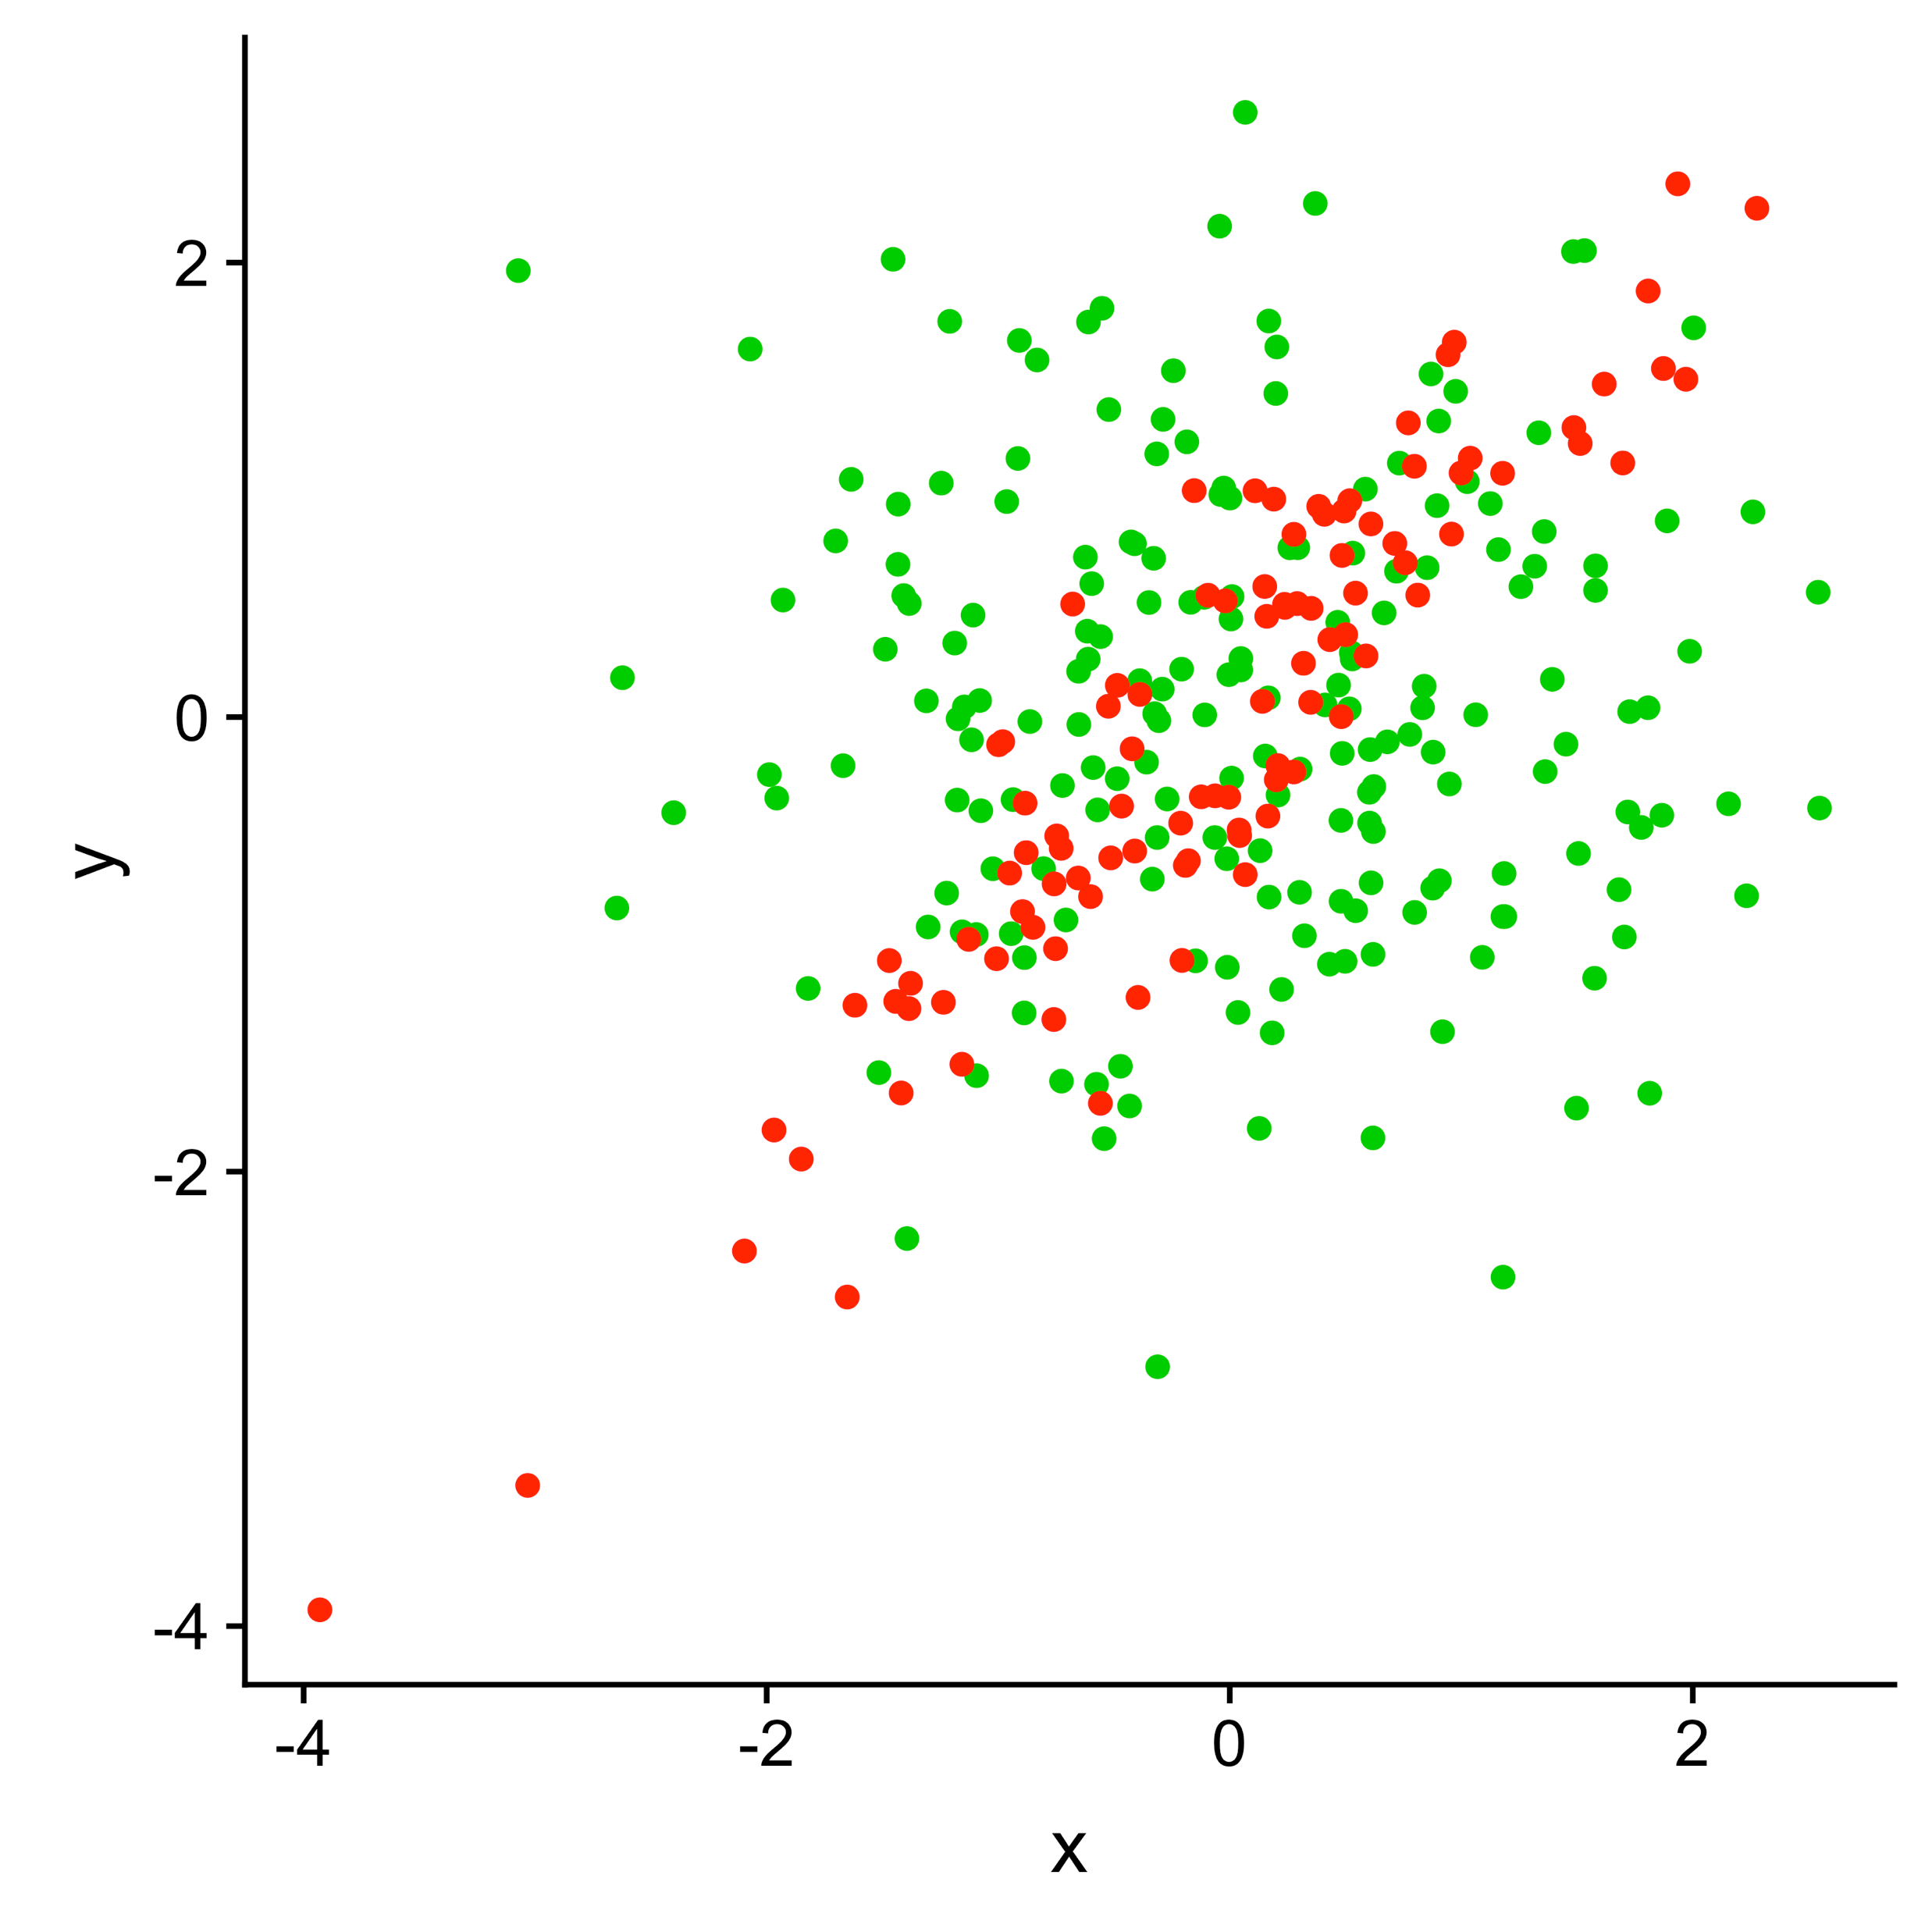
Data Visualization: Color

Slide 21
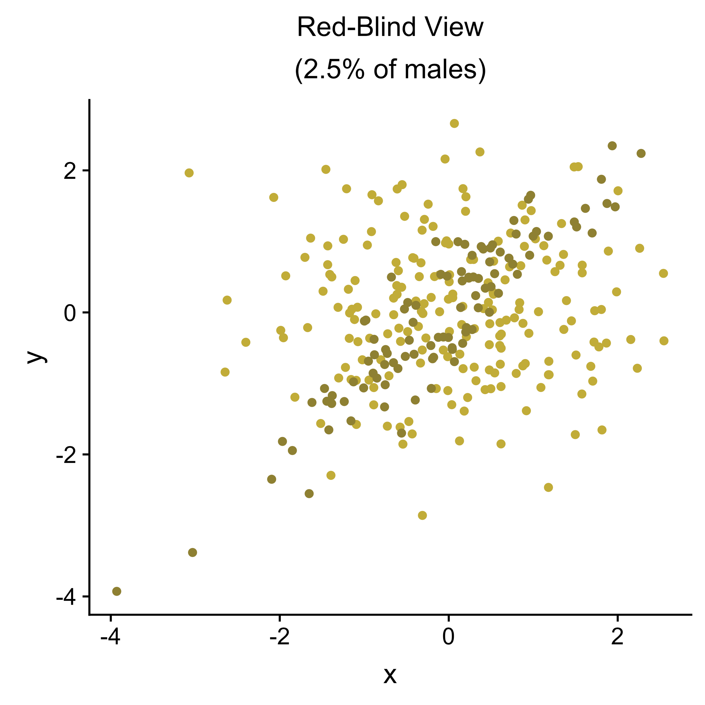

Data Visualization: Color
See https://colororacle.org/ for a good colorblind simulator

Slide 22
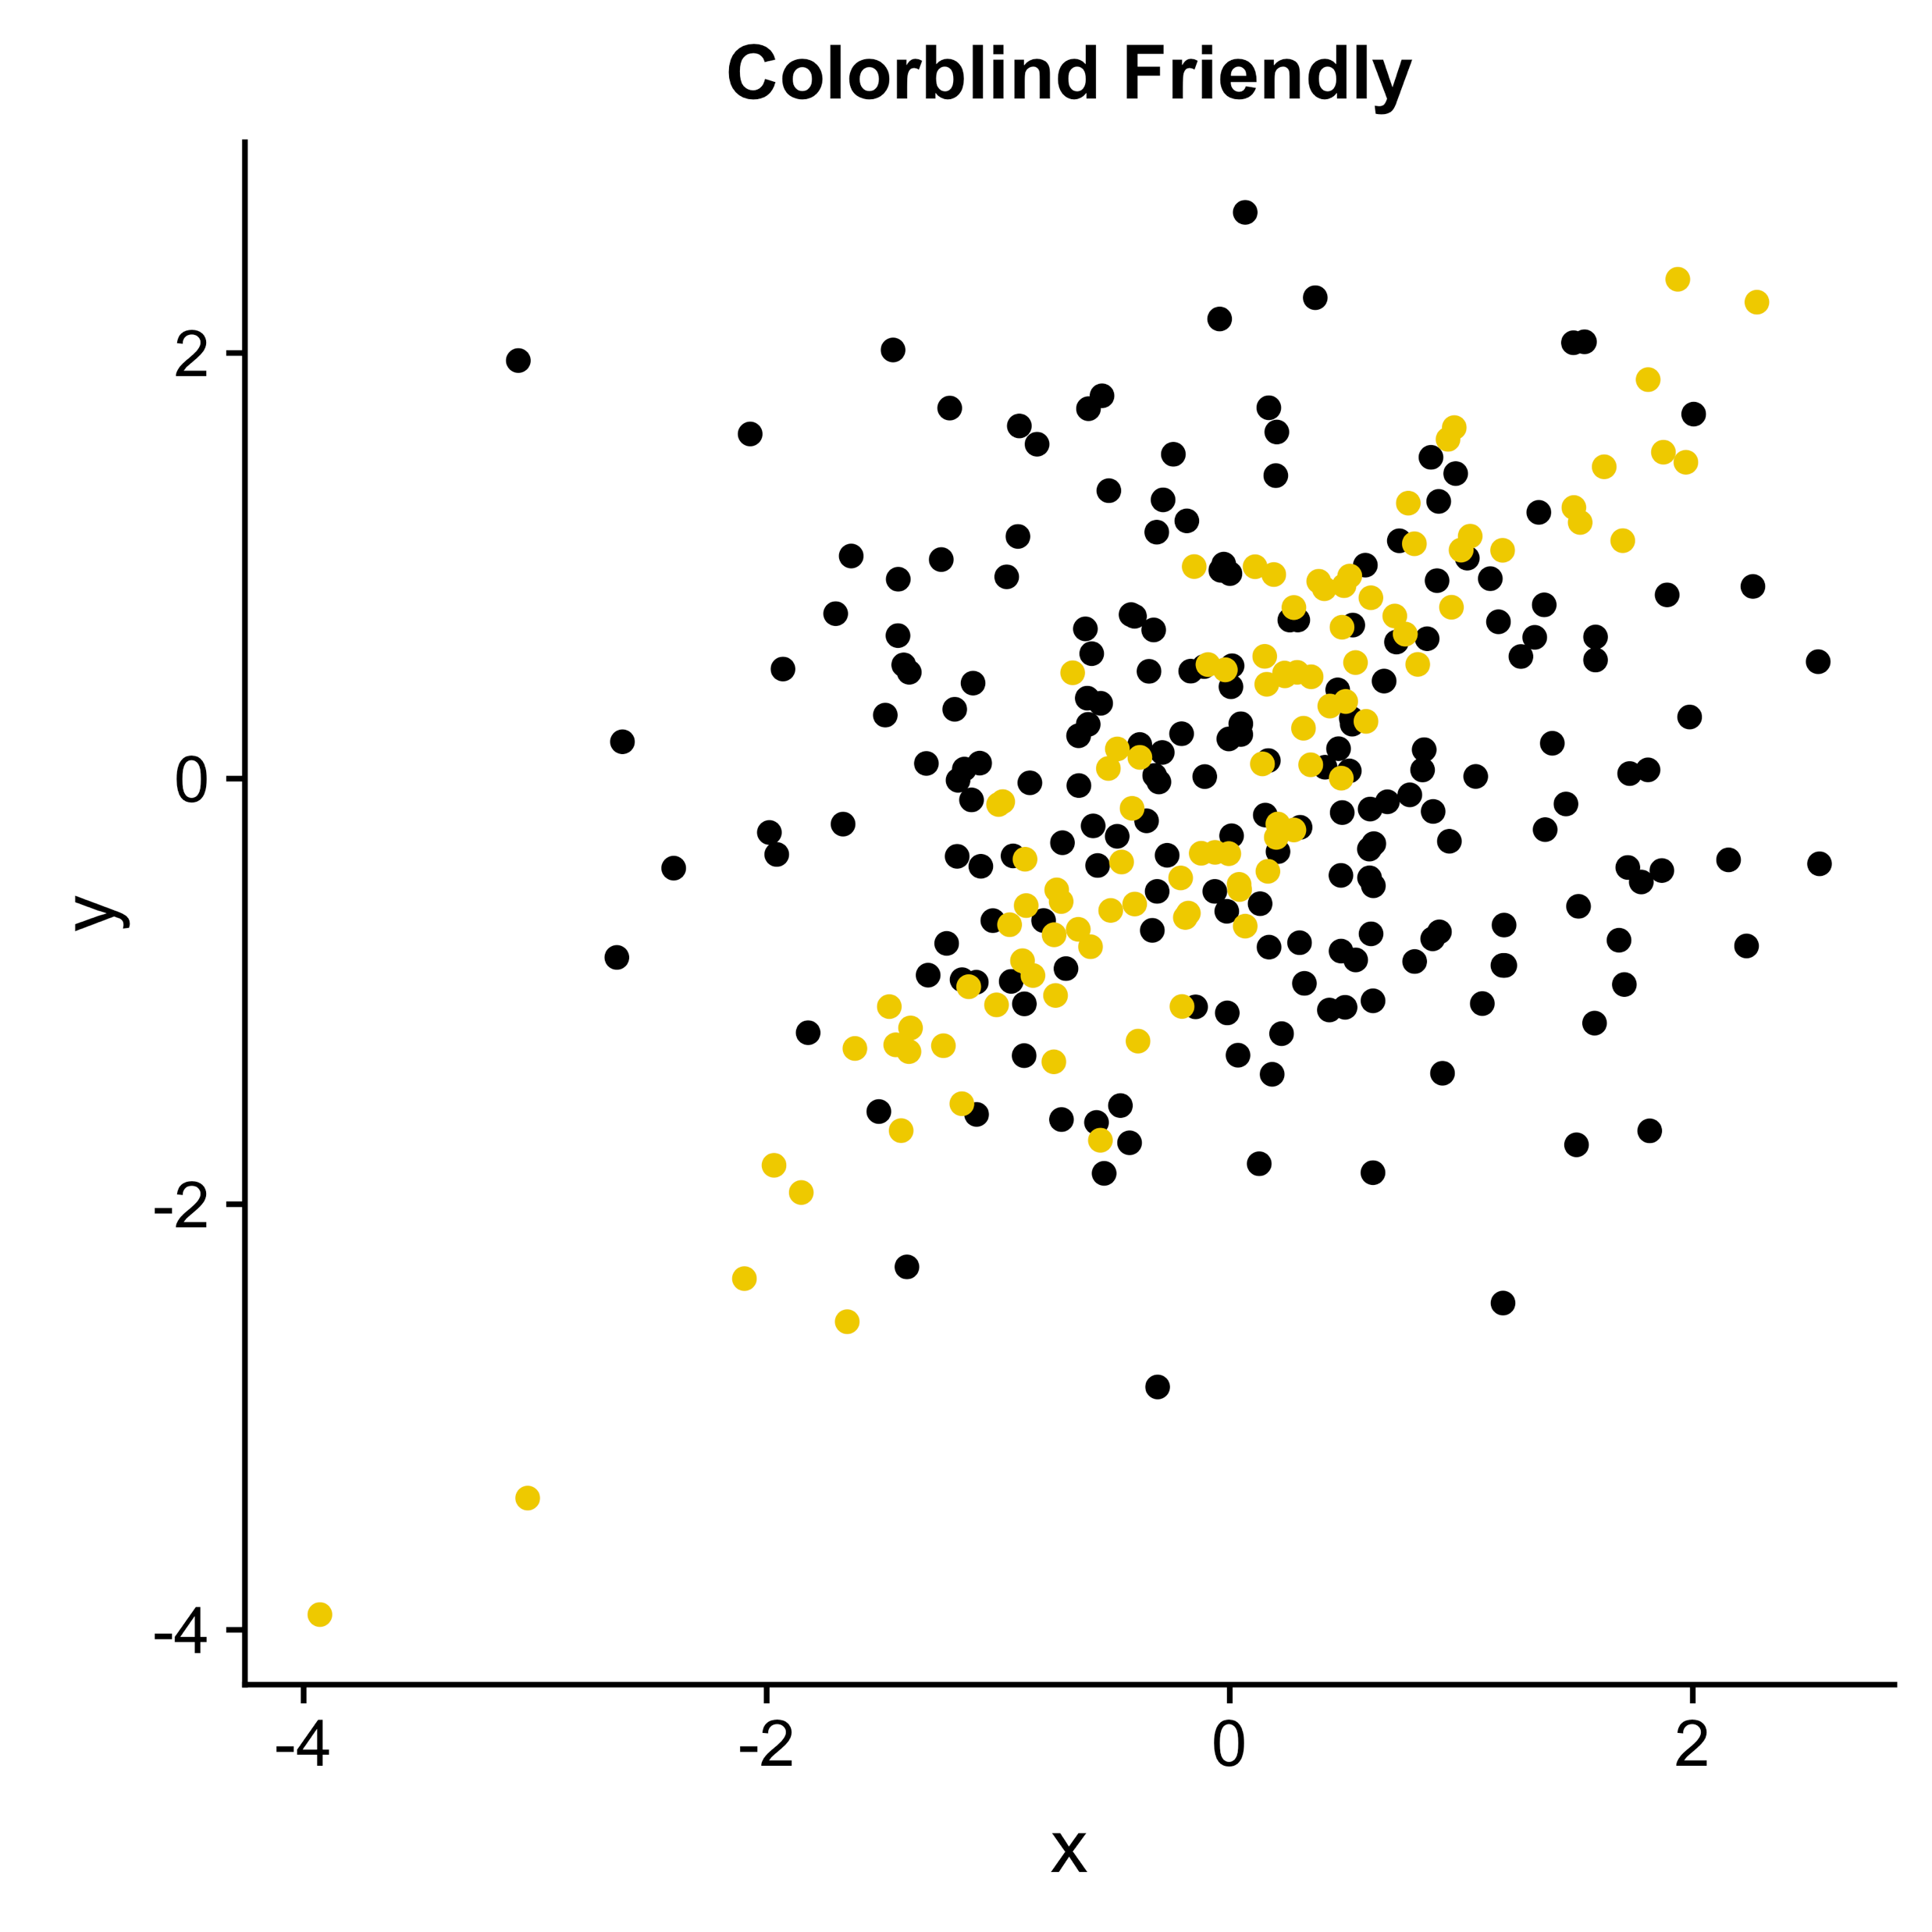
Data Visualization: Color

Slide 23
Scientific Integrity: P-hacking

Slide 24
Scientific Integrity: Data Management

Slide 25
Scientific Integrity: Data Sharing

Slide 26


